Slide 1
"Why Should I Trust You?" Explaining the Predictions of Any Classifier
Teja Gollapudi
Slide Credits : "Why Should I Trust You?“ Explaining the Predictions of Any Classifier, Riberio et al.

Slide 2
How to build an application with ML
Data
Predictions &
decisions
Application
Machine learning model
Trust Challenge
Is model really working?
Convince myself and others?

Slide 3
Learn model
Trust model
Deploy model
Improve model
Make better decisions
Trust AI system
Data
Features
Model
Evaluate
Improve

Slide 4
What do we do to gain trust in ML?

Slide 5
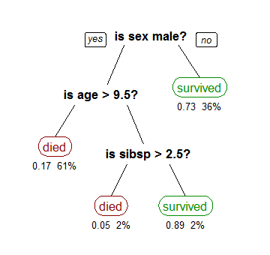
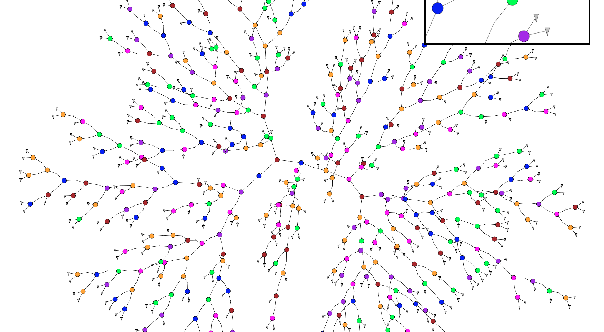
How we try to gain trust…
Interpretable models
Promising, but…
But often not accurate enough
Accuracy
A must have, but…
AKA gut feeling, “I’m the expert”, looks good,…
Voodoo
Slow, expensive, tricky to interpret properly
“Almost” gold standard, but…
A/B testing
Unreliable: data leakage, training data vs. real world, changing environment, objective mismatch

Slide 6
Accuracy problems - example
Test on recent dataset, accuracy only 57%
20 Newsgroups subset –
Atheism vs Christianity
94% accuracy!!!
Predictions due to email addresses, names,…

Slide 7
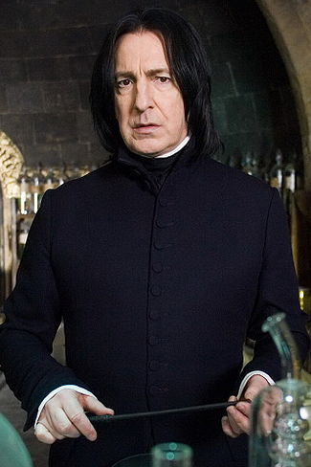
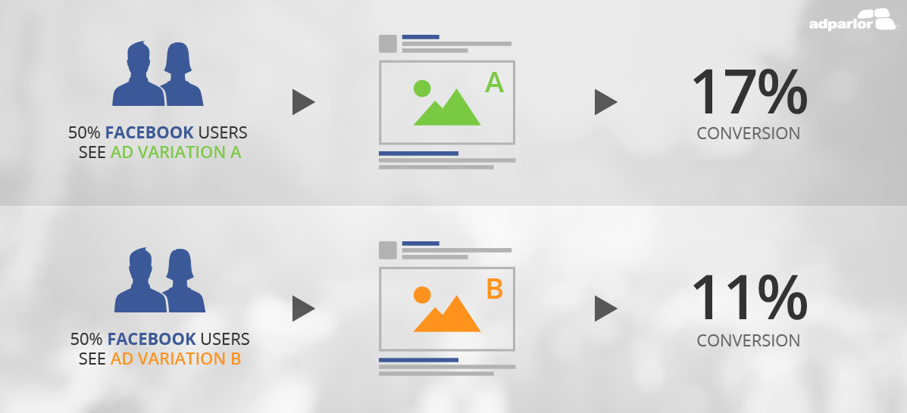
How we try to gain trust…
Interpretable models
Promising, but…
But often not accurate enough
Accuracy
A must have, but…
Voodoo
AKA gut feeling, “I’m the expert”, looks good,…
A/B testing
“Almost” gold standard, but…
Unreliable: data leakage, training data vs. real world, changing environment, objective mismatch
Slow, expensive, tricky to interpret properly [Kohavi et al, KDD2012]

Slide 8
Explaining individual predictions: Making any model interpretable

Slide 9
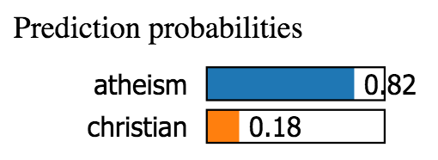
What an explanation looks like
From: Keith Richards
Subject: Christianity is the answer
NTTP-Posting-Host: x.x.com
I think Christianity is the one true religion.
If you’d like to know more, send me a note
Appear in 21% of training
examples, almost always in
atheism
Appears in 11% of training
examples, always in atheism
Why did this happen? How do I fix it?
➔ Will not generalize
➔ Don’t trust this model!

Slide 10
Three must-haves for a good explanation
Interpretable
Faithful
Model agnostic
Humans can easily interpret reasoning
Describes how this model actually behaves
Can be used for any ML model
Definitely not interpretable
Potentially interpretable

Slide 11
Three must-haves for a good explanation
Interpretable
Faithful
Model agnostic
Humans can easily interpret reasoning
Describes how this model actually behaves
Can be used for any ML model
y
Learned model
Not faithful
to model
x

Slide 12
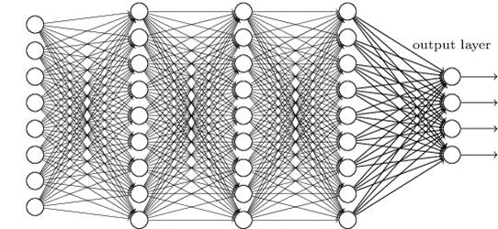
Three must-haves for a good explanation
Interpretable
Faithful
Model agnostic
Humans can easily interpret reasoning
Describes how this model actually behaves
Can be used for any ML model
Can explain this mess ☺

Slide 13
LIME: Local Interpretable Model-Agnostic Explanations

Slide 14
LIME – Key Ideas
Pick a model class interpretable by humans
Not globally faithful… ☹
Locally approximate global (blackbox) model
Simple model globally bad, but locally good
Line,
shallow decision tree,
sparse features, …
Locally-faithful simple decision boundary ➔
Good explanation for prediction

Slide 15
Using LIME to explain a complex model’s prediction for input x_{i}
Sample points around x_{i}
Use complex model to predict labels for each sample
Weigh samples according to distance to x_{i}
Learn new simple model on weighted samples
Use simple model to explain

Slide 16
Interpretable Data Representation
Interpretable explanations need to use a representation that is understandable to humans, regardless of the actual features used by the model.
A possible interpretable representation for text classification is a binary vector indicating the presence or absence of a word, even though the classier may use more complex (and incomprehensible) features such as word embeddings.
For Image classification, an interpretable representation may be a binary vector indicating the presence or absence of a contiguous patch of similar pixels (a super-pixel), while the classier may represent the image as a tensor with three color channels per pixel.

Slide 17
Interpretable representations
x (embeddings)
x' (words)
0.5
0.3
1.3
4.4
1.1
...
This is a horrible movie.
This is what we perturb, and this is what we use
in the interpretable approximation

Slide 18
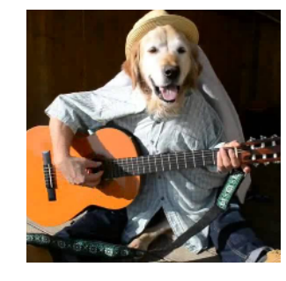
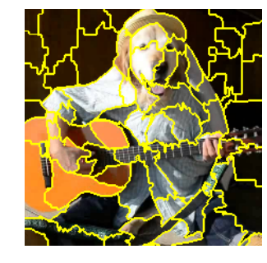
Interpretable representation: images
x (3 color channels / pixel)
x' (contiguous superpixels)

Slide 19
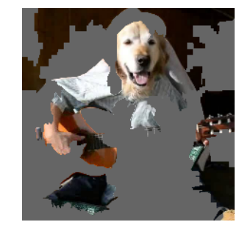
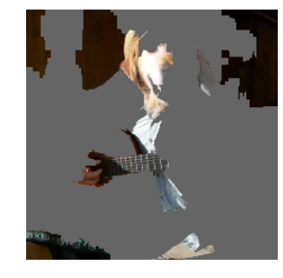
Sampling example - images
Perturbed Instances | P(Labrador)
0.92
Locally weighted
regression
0.001
Original Image
P(labrador) = 0.21
0.34
Explanation

Slide 20
LIME

Slide 21
Fidelity-Interpretability Trade-off
Formally, we define an explanation as a model g € G, where G is a class of potentially interpretable models, such as linear models, decision trees.
The domain of g is , g acts over absence/presence of interpretable components.
Not all g € G may be simple enough for interpretation :
Ω(g) is used to measure complexity of explanation g.
Eg: Ω(g) is depth of tree for decision tree, non-zero weights for interpretable models

Slide 22
Fidelity-Interpretability Trade-off
Model being explained is f :
π_{x}(z) as a proximity measure between an instance z to x, so as to define locality around x.
let L(f; g; π_{x}) be a measure of how unfaithful g is in approximating f in the locality defined by π_{x}.
Minimize L(f; g; π_{x}) while having :Ω(g) be low enough to be interpretable by humans.

Slide 23
Sampling for Local Exploration
In order to learn the local behavior of f as the interpretable inputs vary, we approximate L(f, g, π_{x}) by drawing samples, weighted by π_{x.}
We sample instances around x 0 by drawing nonzero elements of x 0 uniformly at random (where the number of such draws is also uniformly sampled)
Given a perturbed sample ( which contains a fraction of the nonzero elements of x’ ), we recover the sample in the original representation z ∈ R^{d} and obtain f(z), which is used as a label for the explanation model.

Slide 24
Sparse Linear Explanations
G(z’)=w_{g}.z’
Π_{x}(z)=exp(-D(x,z)²/σ²) kernel for distance function D ( eg: cosine distance) with width σ.
For text classification, we ensure that the explanation is interpretable by letting the interpretable representation be a bag of words, and by setting a limit K on the number of words, i.e.

Slide 25
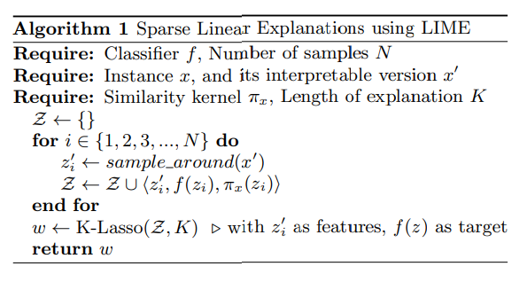

Slide 26
Gaining insights from explanations

Slide 27
Explaining Google’s Inception NN
P( ) = 0.32
P( ) = 0.24
P( ) = 0.21

Slide 28
Train a neural network to predict wolf v. husky
Only 1 mistake!!!
Do you trust this model?
How does it distinguish between huskies and wolves?

Slide 29
Explanations for neural network prediction
We’ve built a great snow detector… ☹

Slide 30
Did machine learning people notice it?

Slide 31
Beyond explaining predictions: Explaining whole models

Slide 32
Explaining model behavior for whole space
Explanation for 1 example
Explaining 1 prediction describes local behavior of model
Pick k predictions to describe overall behavior
Indispensable to avoid redundancy in explanations
Submodular function optimization provides diverse set of explanations
Whole space of data

Slide 33
Explaining model behavior for whole space
Explanation of a single prediction provides some understanding into the reliability of the classifier to the user, it is not sufficient to evaluate and assess trust in the model as a whole.
Pick a diverse, representative set of explanations to show the user { i.e. non-redundant explanations that represent how the model behaves globally.
Construct an nxd’ explanation matrix W that represents the local importance of the interpretable components for each instance.

Slide 34
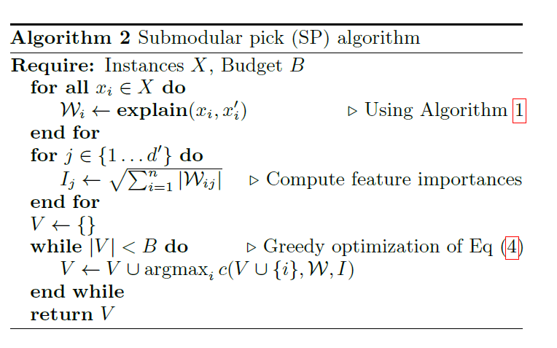
Explaining model behavior for whole space
budget B : time/patience that humans have denoted the number of explanations they are willing to look at in order to understand a model.

Slide 35
Define coverage as the set function c that, given W and I, computes the total importance of the features that appear in at least one instance in a set V .
The pick problem, defined in Eq. (4), consists of finding the set V; |V|< B that achieves highest coverage.

Slide 36
Submodular selection- intuition
Features
John
Christ
Host
NNTP
Mary
Representative explanations
Avoid redundancy
Documents
1
4
2
2
1
Covered Features

Slide 37
Evaluating whole-model explanations

Slide 38
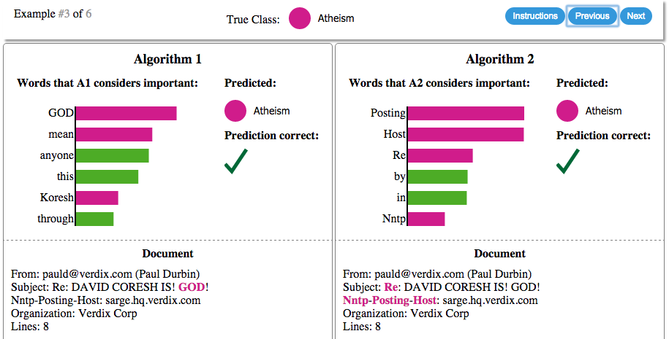
Choosing between competing models
Ask people on Mechanical Turk which model generalizes better

Slide 39
Choosing between competing models
89% of Mechanical Turkers
identify more trustworthy model
If we picked based
on accuracy, we
would get it wrong.

Slide 40
Choosing between competing models
20 newsgroups - Train
20 newsgroups - test
Accuracy:
94%
Accuracy:
89%
Explain
Hidden religion dataset
Accuracy:
Choose which
will generalize
better
57%
69%

Slide 41
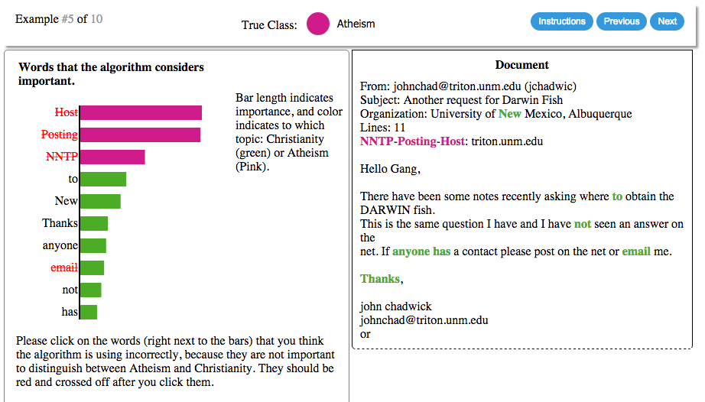
Fixing bad classifiers
Turkers click on 'useless' words for the task in each round

Slide 42
Fixing bad classifiers
Mechanical Turkers can do
‘feature engineering’ really well!
Train on 20 newsgroups
turkers clean data
Train on hand-cleaned
20 newsgroups
Accuracy on hidden set
Train on 20 newsgroups

Slide 43
Fixing bad classifiers
20 newsgroups - Train
Hidden religion dataset
Evaluate
train
predict
REPEAT
20 newsgroups - test
Turkers don’t know about this dataset
Explain

Slide 44
Conclusion

Slide 45
LIME
Trust
Does my model really work?
Insights
What is my model doing?
Improve
How do I fix my model?
Open source project: https://github.com/marcotcr/lime

