Slide 1
Man is to Computer Programmer as Woman is to Homemaker? Debiasing Word Embeddings Speaker: Mina Valizadeh CS 594 – Paper Presentation October 2020

Slide 2
Man is to Computer Programmer as Woman is to Homemaker? Debiasing Word Embeddings
Tolga Bolukbasi, Kai-Wei Chang, James Zou, Venkatesh Saligrama, Adam Kalai Boston University, Saint Mary’s Street, Boston, MA Microsoft Research New England, 1 Memorial Drive, Cambridge, MA
Published at NIPS 2016
2

Slide 3
Outline
Background
Problem Description
Definitions & Tools
Methodology
Discussion & Conclusion

Slide 4
Outline
Background
Problem Description
Definitions & Tools
Methodology
Discussion & Conclusion

Slide 5
Background

Slide 6
How do we represent the meaning of a word?
Definition: meaning (Webster dictionary)
the idea that is represented by a word, phrase.
the idea that a person wants to express by using words, signs.
the idea that is expressed in a work of writing or art.

Slide 7
Representing words as discrete symbols
In traditional NLP, we regard words as discrete symbols: hotel, conference, motel - a localist representation
Words can be represented by one-hot vectors:
motel = [0 0 0 0 0 0 0 0 0 0 1 0 0 0 0] hotel = [0 0 0 0 0 0 0 1 0 0 0 0 0 0 0]
Vector dimension = number of words in vocabulary (e.g., 500,000)

Slide 8
Representing words as discrete symbols
Example: in web search, if user searches for “Seattle motel”, we would like to match documents containing “Seattle hotel”.
But: motel = [0 0 0 0 0 0 0 0 0 0 1 0 0 0 0] hotel = [0 0 0 0 0 0 0 1 0 0 0 0 0 0 0]
These two vectors are orthogonal.
There is no natural notion of similarity for one-hot vectors!
What Should we do now?
Learn to encode similarity in the vectors themselves.

Slide 9
Representing words by their concept
Distributional semantics:
A word’s meaning is given by the words that frequently appear close-by.
When a word w appears in a text, its context is the set of words that appear nearby (within a fixed-size window).
Use the many contexts of w to build up a representation of w
These context words will represent banking

Slide 10
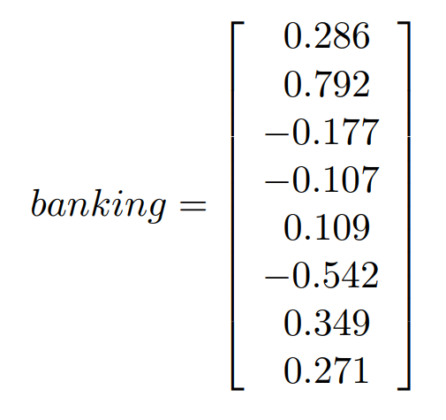
Word Vectors
We will build a dense vector for each word, chosen so that it is similar to vectors
of words that appear in similar contexts.
Word vectors are sometimes called word embeddings or word representations.
They are a distributed representation.

Slide 11
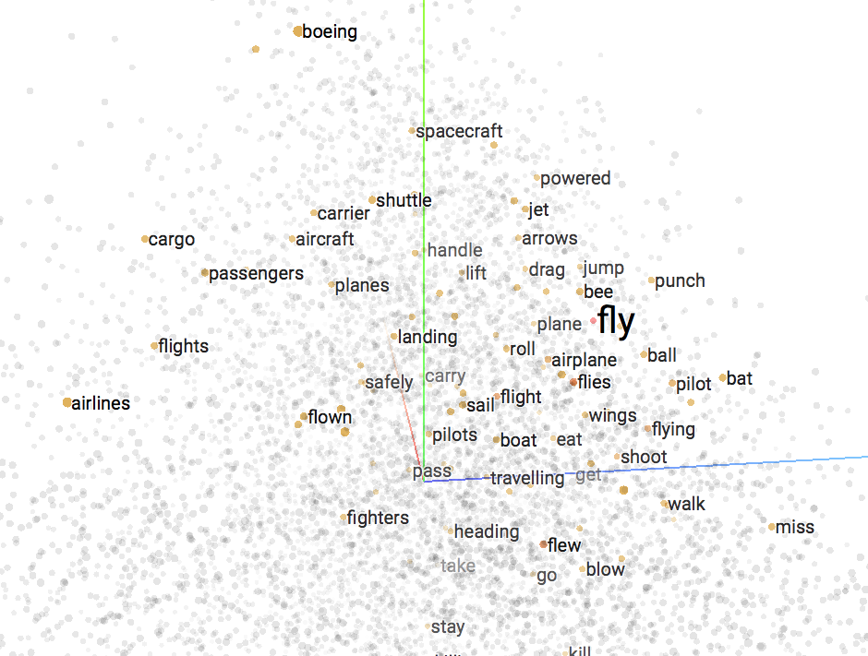
Word Embeddings
Each word in the vocabulary is represented by a low dimensional vector (300d).
Serve as a dictionary for computer programs that would like to use word meaning.
Word2vec (Mikolov et al. 2013) is a framework for learning word vectors.

Slide 12
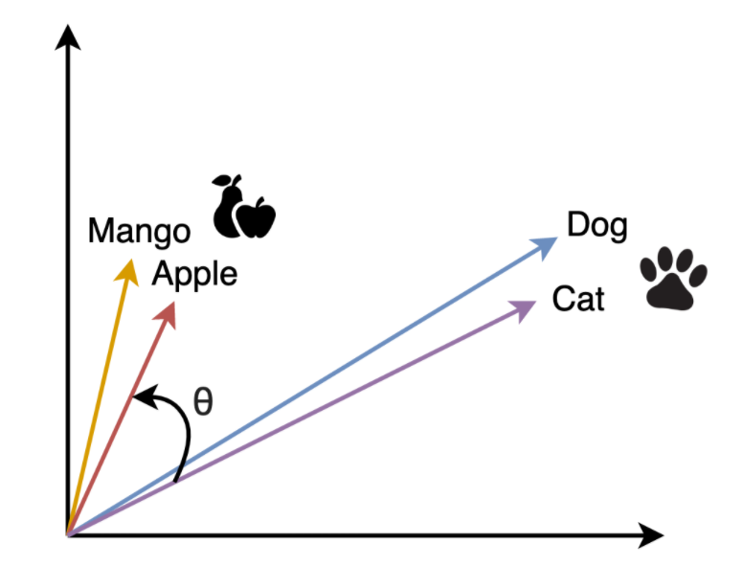
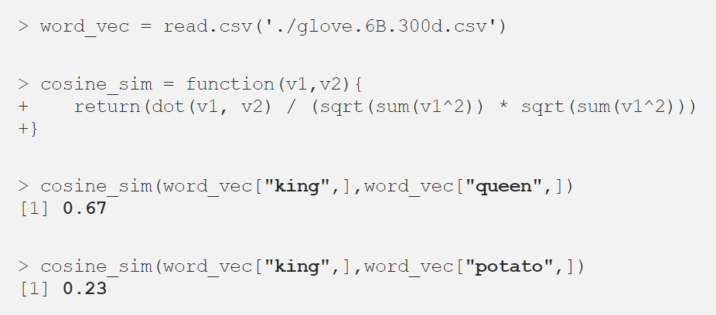
Word Embeddings
Similar words have similar vector.

Slide 13
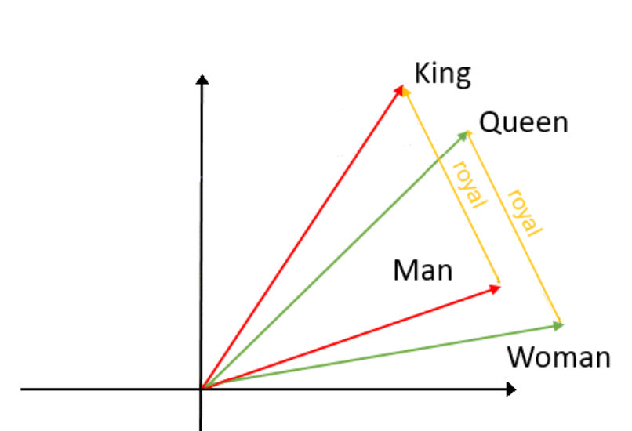
Word Embeddings
The vector differences between words in embeddings have been shown to represent relationships between words.
Analogy puzzle
A man is to king as woman is to ?
man:king :: woman:x

Slide 14
Outline
Background
Problem Description
Definitions & Tools
Methodology
Discussion & Conclusion

Slide 15
Problem Description

Slide 16
Gender in an Elevator Scenario
Language is one of the most powerful means through which sexism and gender
discrimination are perpetrated and reproduced.

Slide 17
Gender bias through word clouds
Looking at K-nearest embedding neighbors of man and woman
Man
Occupation
Scientist
Surgeon
Computer programmer
Adjectives
Brilliant
Clever
Professional
Woman
Occupation
Midwife
Nurse
Receptionist
Adjectives
Sexy
Attractive
Gorgeous
A man is to computer programmer as woman is to ?

Slide 18
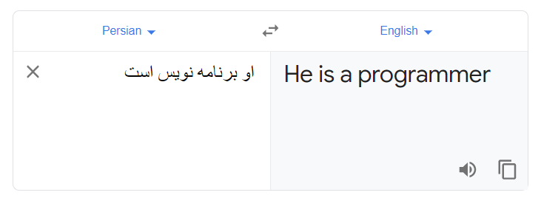
Gender bias in Google translate

Slide 19
Why is this problem important?

Slide 20
Retrieving relevant web pages for a given query
Search query : “CMU computer science ph.d. student “
The directory offers 127 nearly identical web pages for students.
These pages differ only in the names of the students.
Word embeddings also rank terms related to computer science closer to male names than female names.
The usage of word embedding makes it harder for women to be recognized as computer scientist.
It would contribute to widening the existing gender gap in computer science.

Slide 21
Outline
Background
Problem Description
Definitions & Tools
Methodology
Discussion & Conclusion

Slide 22
Definitions & Tools

Slide 23
Word Definitions
1. Gender specific words
The words that are associated with a gender by definition.
Examples: brother, sister, businessman, businesswoman
The fact that the brother is closer to man than to woman is expected, why?
2. Neutral words
The words that are not specific are considered as neutral.
Examples: doctor, shoes, receptionist
The gender-neutral word embeddings acquire stereotype and bias.

Slide 24
Tasks
Main goal:
* To understand the biases present in the word-embedding.
* To reduce bias in gender-neutral words, preserve the gender factor in gender specific words.
Two simple methods to approach this problem:
Evaluate whether the embedding has stereotypes on occupation words
Evaluate whether the embedding produces analogies that are judged to reflect stereotypes by humans

Slide 25
Word embedding used in this paper
Primary embedding: Publicly-available word2Vec.
Trained on a corpus of Google News texts consisting of 3 million English words.
Terms into 300 dimensions
Refer to as the w2vNEWS
Does w2vNEWS exhibit smaller gender bias than other word embeddings?

Slide 26
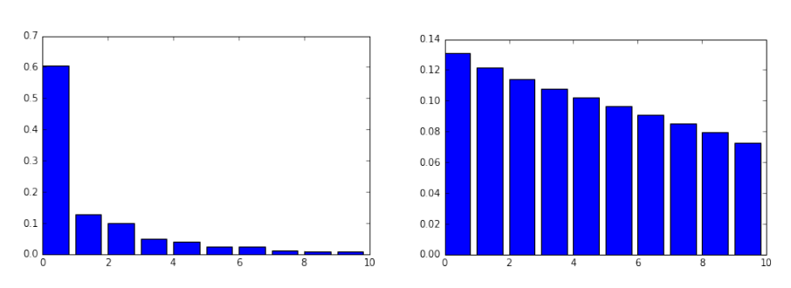
Identifying the gender subspace
Should identify a bias direction
The direction can help us to quantify biases in words & associations
Steps:
Asking Amazon Turk crowd-workers to generate possible word pairs
Define a classification Task
The accuracy of the classifier indicates that how much the pairs capture the intuitive notion of gender.

Slide 27
Types of Bias
Direct bias
Indirect bias

Slide 28
Direct Bias
Words like ‘receptionist’ are much closely related to females while ‘football’ is closer to males. This is called direct bias.

Slide 29
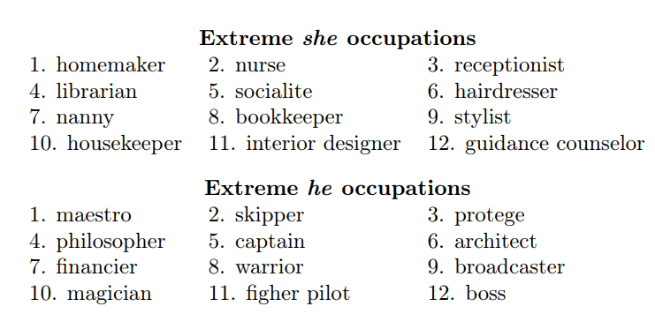
Direct Bias
Asking crowd-workers to evaluate whether an occupation is considered as female-stereotypic, male-stereotypic, or neutral.

Slide 30
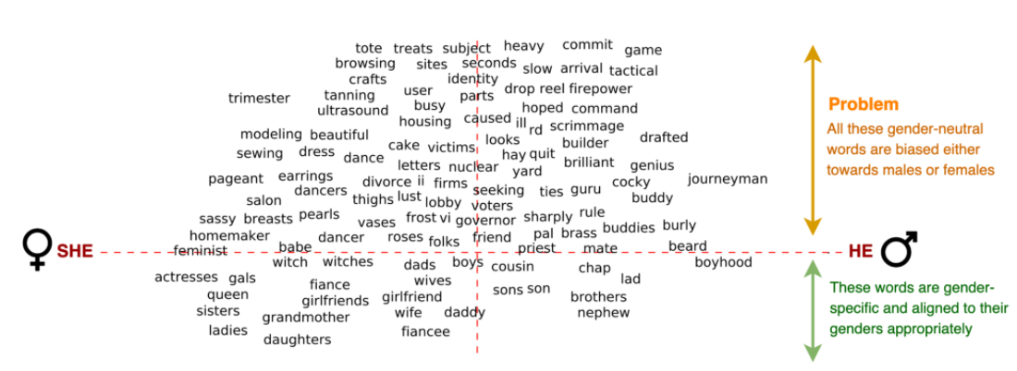
Direct Bias
2. Projecting the occupation words onto the she-he axis
x-axis: a projection onto the difference between the embeddings of the words he and she
y-axis: a direction learned in the embedding that captures gender neutrality

Slide 31
Direct Bias
How to measure direct bias?
Working on words that should be gender-neutral.
N: Set of neutral words
g: Gender direction
c: How strict do we want to in measuring bias
When c = 0?
When c = 1?

Slide 32
Indirect Bias
A word that should be gender neutral, such as receptionist, is closer to softball than football.
Defining the gender component metric:
When β(w, v) = 0?
When β(w, v) = 1?

Slide 33
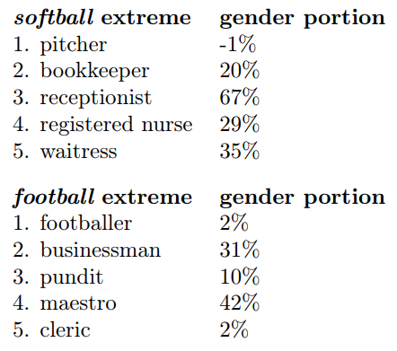
Indirect Bias
Project all the occupation words on to the softball-football direction
Looking at the extreme words
Looking for the pairs that create indirect gender bias

Slide 34
Outline
Background
Problem Description
Definitions & Tools
Methodology
Discussion & Conclusion

Slide 35
Methodology

Slide 36
Debiasing Algorithm (Hard-Debiasing)
This algorithm has 3 steps:
Identify gender space
Neutralize
Equalize

Slide 37
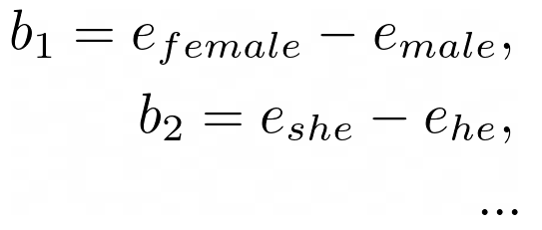
Identify gender space
Debiasing Algorithm
Identify the dimension where the bias is captured in the embedding.
Take the difference between sets of word embeddings (denoted by e) which define the concept of gender.
Bias subspace is calculated by taking the SVD of these differences.
38

Slide 38
Neutralize
Debiasing Algorithm
Remove the bias components from all gender-neutral words.
By subtracting the embedding’s projection onto the bias axis b (using the dot product of e & b)
39

Slide 39
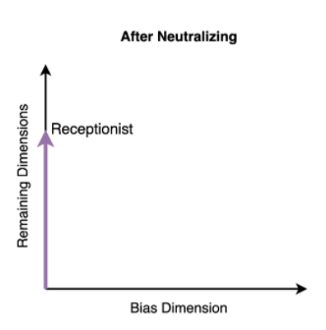
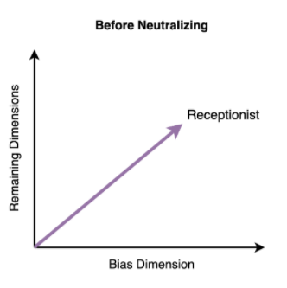
After neutralizing, the bias in a gender-neutral word is removed.
Debiasing Algorithm
40

Slide 40
Equalize
Debiasing Algorithm
We take care of the gender-specific words in this step.
For every gender-specific word, we equalize their vector lengths, such that, the gender component is preserved with equal strength in all pairs of words.
41

Slide 41
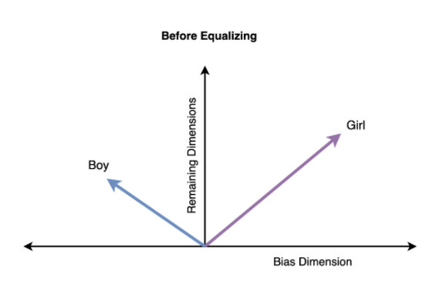
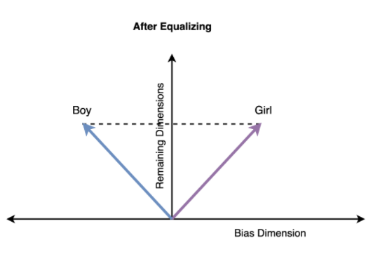
After equalizing, the gender component is equal in gender-specific words.
Debiasing Algorithm
42

Slide 42
Debiasing Algorithm (Soft Bias Correction)
Formalizing an optimization problem:
W: Matrix of all embedding vectors
N: Matrix of the embedding vectors corresponding to gender neutral words
T: Debiasing Transformation (Linear transformation)
lambda: Tunning Parameter

Slide 43
Outline
Background
Problem Description
Definitions & Tools
Methodology
Discussion & Conclusion

Slide 44
Discussion & Conclusion

Slide 45
Evaluations (Direct Bias)
Pairs of words that are similar to he-she are generated automatically
Crowd-workers are asked to check whether it has stereotypes
Before applying hard-debiasing algorithm:
19% of the top 150 analogies were judged as biased.
After applying hard-debiasing algorithm:
only 6% of the top 150 analogies were judged as biased.
Soft-debiasing was less affective in removing gender bias, but it is still working in some extent for this task.

Slide 46
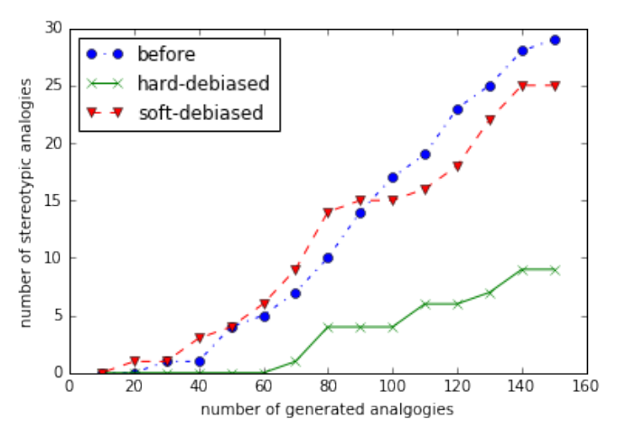
Evaluations (Number of stereotypical)

Slide 47
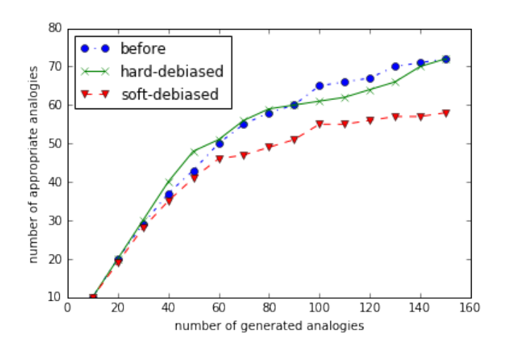
Evaluations (Appropriate Analogies)

Slide 48
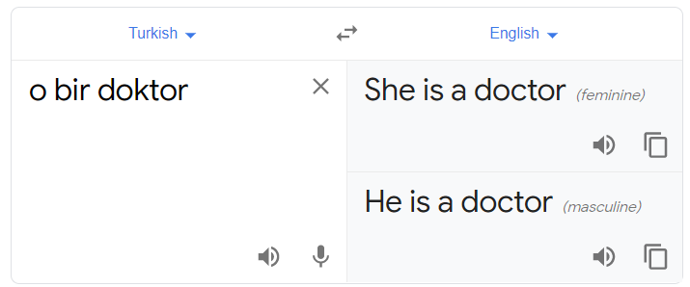
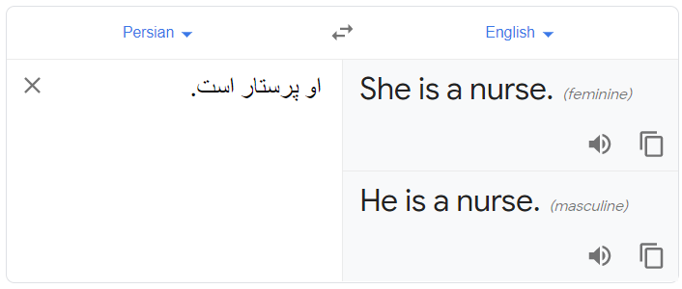
Google Translate After applying the debiasing algorithm

Slide 49
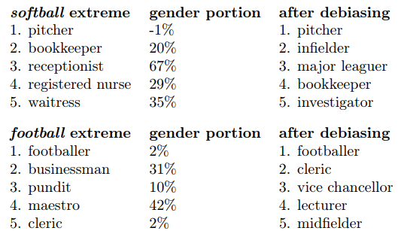
Evaluations (Indirect Bias)
It is challenging to quantify the performance of the algorithm for indirect bias.
We do see promising qualitative improvements.

Slide 50
Future Work
Understanding direct and indirect bias due to racial, ethnic, and cultural stereotypes.
Consider how the approach and findings here would apply to other languages

Slide 51
Thank you! Any questions?

